Slide 1
Unidentified

Slide 2
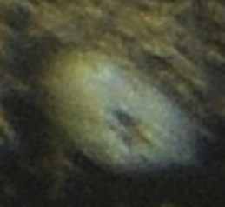
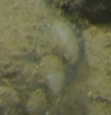
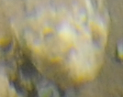
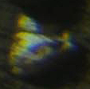
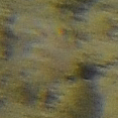
Unidentified 4
White globular blob. Could be a sponge or ascidian.
Unidentified 1
White sediment covered, vase shaped organism. Could be a sponge or ascidian.
Unidentified 8
Circular white organisms. Possibly Anomia or Porifera.
Unidentified 6
Branching purplish organism.
Notes:
We don’t record things that are buried unless it’s an ophiuroid.

Slide 3
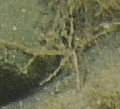
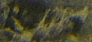
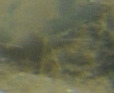
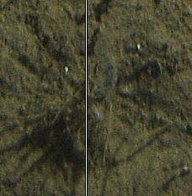
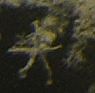
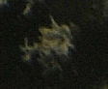
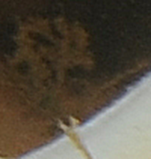
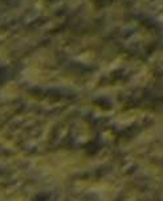
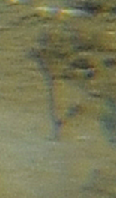
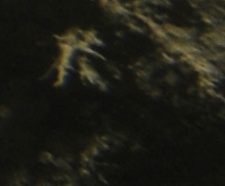
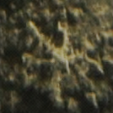
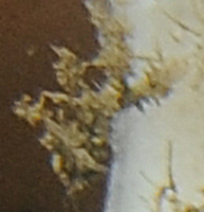
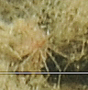
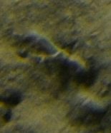
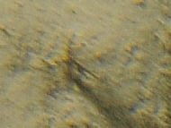
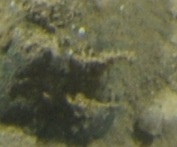
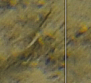
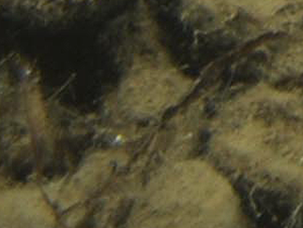
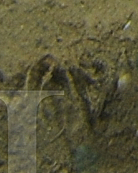
Unidentified 2
Thin white or sediment coloured branching organism. Could be a bryozoan or a hydroid.

Slide 4
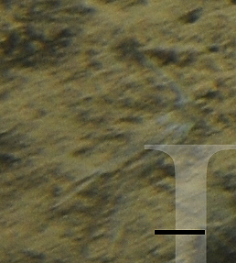
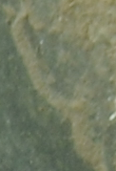
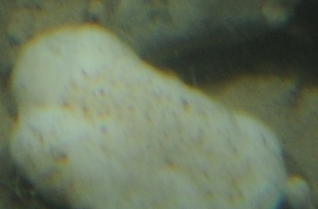
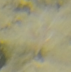
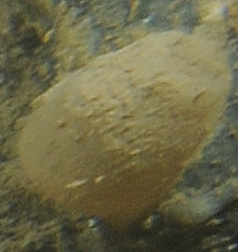
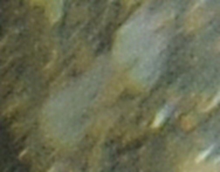
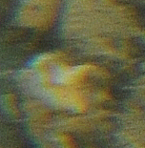
Unidentified 13
White globular blob with specks that could be oscula. Could be a sponge or Didemnidae ascidian. Sponge!
Unidentified 10
White thin strands.
Unidentified 12
Sediment covered thin organism. Could be a Terebellid worm
Unidentified 19
White or grey encrusting organism. Could be Porifera.
Unidentified 18
Semi-transparent branching organism. Could be Unidentified 6
Unidentified 17
Sediment covered globular-shaped organism.
Unidentified 14
White blob. Could be a sponge.

Slide 5
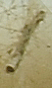
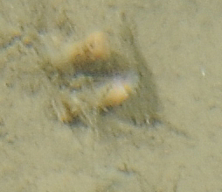
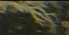
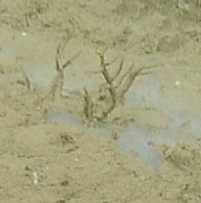
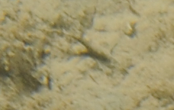
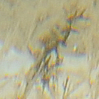
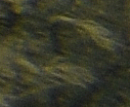
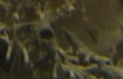
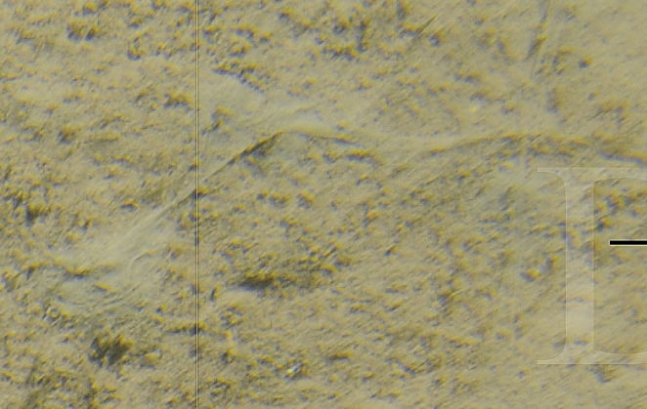
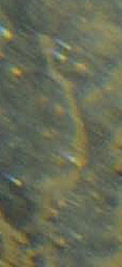
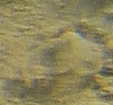
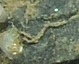
Unidentified 20
Orange polyp. Could be Zooanthidae (O.) sp. 1.
Unidentified 21
Sediment coloured erect branching organism, occasionally found on V. pourtalesi. Branches all come from an axial stalk. Could be bryozoan.
Unidentified 22
Tubes on Vazella pourtalesi.
Unidentified 25
Long thin sediment covered organism. Could be an Annelid.
Unidentified 23
Thin sediment coloured, stringy or mucous like organism.
Unidentified 24
Sediment covered organism.

Slide 6
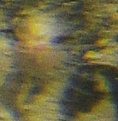
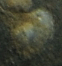
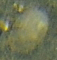
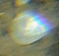
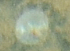
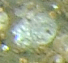
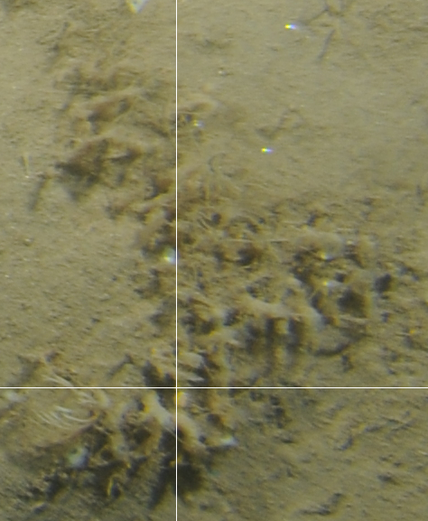




Unidentified 26
Pinkish tentacles with lighter base. Could be Actiniaria species.
Unidentified 27
Thin pale organism. Could be sediment covered Serpulid worm.
Unidentified 28
Thin pale round semi-translucent encrusting organism with white spots in the centre.
Unidentified 31
Pale semi-transparent encrusting organism.
Unidentified 29
Sediment covered yellow plate-like organism.
Unidentified 30
Sediment covered white colonial organism.

Slide 7










Unidentified 32
Orange thin tube-like organism. Partially sediment covered. Could be a nemertea
Unidentified 35
Purple organism. Could possibly be a juvenile sea pen.
Unidentified 34
Redish organism?
Unidentified 33
Thin straight organism with a curled tip.
Unidentified 38
Sediment coloured dome-shaped organism on a rock.
Unidentified 46
Thin feathery sediment coloured organism. Often with a curve at the tip.
Unidentified 41
Tubes with orange tufts on top.
Unidentified 48
Yellow bacterial mat on rock.

Slide 8











Unidentified 52
Peach/sediment coloured circular organism on rock. Brachiopods Terebratulina
Unidentified 53
White thin long organism.
Unidentified 54
White flat disk-shaped organism in the sediment
Unidentified 49
Pinkish bacterial mat on a rock.
Unidentified 55
Sediment covered whitish blob.
Unidentified 56
Grey round organism on rock.
Unidentified 57
Pile of small casings?

Slide 9











Unidentified 61
Long sediment covered thin worm-like organism.
Unidentified 59
Thin feather-like branching sediment coloured organism.
Unidentified 63
Yellow-orangish blob with what looks like small oscula.
Unidentified 68
Round oblong white-grey organism.
Unidentified 65
Cylindrical white organism with darker stripe in middle.
Unidentified 64
Round oblong sediment covered organism with what might be an opening on top. Likely an ascidian.
Unidentified 71
Sediment covered tube with a yellowish tip. Could be Unidentified 41

Slide 10










Unidentified 72
White oblong organism with a slit down the centre. Partially covered by sediment.
Unidentified 74
Sediment coloured round organism with two thin branches on either side. Found inside burrow.
Unidentified 73
Sediment covered organism, often coiled. Could be an annelid.
Unidentified 76
Redish worm-like organism partially covered in sediment.
Unidentified 81
Dark curled organism on Unidentified 82. Could be either some sort of worm or arms of an ophiuroid.
Unidentified 79
Red sheet-like organism with small dots or openings.
Unidentified 80
White twisted strands on soft sediment.
Unidentified 82
White vase shaped organism with specks that could be oscula.

Slide 11









Unidentified 83
Long tube-like organism. Mostly sediment coloured and pink at one end.
Unidentified 87
Sediment coloured sac-shaped organism with a thin appendage protruding from one end.
Unidentified 85
Sediment coloured. Sticking off of Vazella pourtalesi.
Unidentified 86
Light blue organism in soft sediment. Slightly dome-shaped with a distinct lighter patch in the middle.
Unidentified 89
Fuzzy mass of spicules on soft sediment. Sometimes in a ball shape, but often in no particular shape.
Unidentified 91
Dark wispy branching organism.

Slide 12










Unidentified 95
Erect stalk with sediment coloured base turning to white and a purple tip. Possibly a Sabellid worm.
Unidentified 96
White oblong organism in soft sediment.
Unidentified 92
Peach-translucent coloured oblong organism with a hole on top. Could be an ascidian.
Unidentified 97
Erect yellow thin organism.
Unidentified 98
Tubes with orange tufts at the end.
Unidentified 100
White tufts inside V. pourtalesi with Crustacea (SP.) sp. 1, could be on its back.
I wonder if this is a piece of tissue the crab ripped off?
Unidentified 102
Very long thin brown/tan cord-like object. Could be the stock of a hydroid, Leptothecatae.
Unidentified 99
Long thin whitish stalk.

Slide 13










Unidentified 103
White round, slightly raised organism in sediment or on a rock. Has a slight sheen on surface and often seen with lighter spots. Possibly Anomia.
Unidentified 106
Partially buried worm-like organism. Light pink around the edges and a darker orange-pink in the centre. Could be a nemertean.
Unidentified 105
Mass of pale blue circles with white-purple edges. Must be close together to count
Unidentified 111
Thin curled sediment coloured worm-like or tube-like object.
Unidentified 112
Thin red-orange organism on rock. Partially sediment covered.
Unidentified 110
Thin branching whitish organism in soft sediment. Could be a crinoid.
Unidentified 109
Green thin stalk with a bulge at one end. Might belong with the Heterokontophyta

Slide 14










Unidentified 115
Dark object, with a relatively thick stalk or column and branching at the tip. Only partially visible. Not likely to be part of Ceranthidae (F.) sp. 1.
Unidentified 113
Sediment coloured round-globular object with a few openings on top and perhaps an arm?
Unidentified 116
Pink cylindrical organism on V. pourtalesi.
Unidentified 114
Sediment covered thick tube-shaped object on rock.
Unidentified 120
Banded conical long tube-shaped organism with a yellowish brown tuft at the tip.
Unidentified 118
Whiteish organism on spicule covered rock or soft sediment.
Unidentified 123
Pale-sediment coloured organism in the sediment. Slight star shape.
Unidentified 122
Mass of small orange clumps in sediment.

Slide 15








Unidentified 128
Grey dome-shaped organism with bright white speckles and an opening on top.
Unidentified 126
Orange-pink blob on rock. Might be an Actiniaria or a sponge. To blurry to identify. Confident it’s an anemone.
Unidentified 127
Round sediment covered organism with small openings. White sponge attached. Could be unidentified 64/an ascidian. This is Porifera sp. 25.
Unidentified 125
Orange branching organism with curls at the tips of the branches. Attached to rock. This is some sort of bacterial/algal mat on rock.
Unidentified 130
White semi-translucent thin object. The rest could be sticking out of the sediment.
Unidentified 129
Orange mass in the sediment.
Unidentified 134
Sediment coloured stalk with a white, flower-bud like tip. The one on the right is a dead crinoid stalk.

Slide 16









Unidentified 140
Cloudy film-like blob. Could be dust cloud.
Unidentified 136
Small orange disk with what appears to be thin arms protruding.
Unidentified 137
Sediment coloured, oval-shaped body with what appears to be several protruding limbs
Unidentified 138
Cylindrical sediment-coloured organism.
Unidentified 142
Very thin, sediment covered thin organism in a spiral arrangement.
Unidentified 141
Fuzzy or spongy sediment-coloured blob, could possibly be very damaged V. pourtalesi.

Slide 17









Unidentified 147
Thin semi-translucent pale blue film. Has more a blueish tinge and less cloudy-white, so not included in Porifera sp. 2, but could be a Porifera.
Unidentified 145
Cylindrical bulbous organism attached to a rock. Transparent with pink internal organs. Could be a retracted anemone, but appears to be too transparent.
I think these two examples are different, with the one on the right being an anemone.
Unidentified 146
Flat, white round disc with very thin tentacles protruding from the edge. Could be a Cnidaria but unable to see organism fully. This is an anemone.
Unidentified 152
Blue-grey organism. What appears to be a central disc with a protrusion off one side. Could be a buried Ophiuroid.
Unidentified 148
Pale blue encrusting organism on rock. Could be Porifera or Unidentified 147, but too blurry to tell.
Unidentified 151
Encrusting yellow organism on rock. Too blurry to see any greater detail.

Slide 18








Unidentified 155
Grey round organism with distinct round opening on top. Either attached to rock or on soft sediment beside rock.
Unidentified 156
Grey organism on rock. Lighter white dot in centre.
Unidentified 153
Cushiony white blue encrusting organism. Could be a Porifera because it appears to have oscula, but uncertain.
Unidentified 154
Orange bacterial mat on rock.
Unidentified 160
Dark squiggly hook shaped organism.
Unidentified 157
Red thin bacterial mat on rock.
Unidentified 158
Long thin, sediment coloured tube-like organism.
Unidentified 159
Dark spindly organism with long protrusions.
This is a filament.

Slide 19







Unidentified 162
Red organism, slightly pointed at one end. Appears to be partially covered in sediment. White-purple tip. Possibly a buried bivalve with umbo visible.
Unidentified 161
Redish organism on Vazella pourtalesi. Appears to have several long thin arms. Could be an ophiuroid.
Unidentified 163
Peach coloured, conical tube-shaped organism. Often with a purple tip.
Unidentified 164
Sediment coloured tubes that appear to be connected at the centre, similarly to ophiuriods’ organization.
Unidentified 165
White organism. Appears to be tapering to one end, growing on sediment
Notes:
Lindsay looked till Unidentified 157

Slide 20









Unidentified 168
Red filaments , rel. small . Colonial? Found on dead vazella.
Unidentified 166.
Sediment covered object. Irregular bumps, and a relatively smooth surface. Possibly a sponge covered in sediment.
Unidentified 167
Purple coloured organism (annelid?). Appears to be attached to the sediment.
Unidentified 169
Globular encrusting organism on rock. Sediment-covered, oscula?
Unidentified 172
Sabellidae sp. Fan-like appendage attached to a white column.
Is this larger than 1 cm?
Unidentified 171
Buried, cloudy white sponge-like object. Holes that resemble oscula.
Unidentified 170
Solid white object. Could be shell hash or a sponge/fragment of a sponge?

Slide 21




Unidentified 173
Erect tube from the sediment, possibly sabellidae.
Unidentified 174
Tubular organism, could be a fragment. Brown, terminating to a short white tip.
Unidentified 175
Bushy, branching organism found on rock. Corallia?
Unidentified 176
Thin tube/stalk around 1cm which extends to a flower-like bud.
Unidentified 177
Possibly an ascidian or cnidarian. White, globular shaped with what appears to be tentacles protruding from the “mouth”.

Slide 22
Trawl Mark

Slide 23

Trawl Mark

Slide 24
Biogenic structures

Slide 25

Shell hash
Notes:
Shell hash photo (13-08-2016: CON 20 190718).

